Slide 1


Intro to J2ME
Taken from Vidya Setlur’s Course on Java
4 – Gaming (Part 1)
Nathan Eagle, PhD
Research Scientist
MIT Design Laboratory
Massachusetts Institute of Technology
April 2007
GSTIT, Addis Ababa, Ethiopia

Slide 2
MIDP 2.0 and Gaming
J2ME is a popular platform for developing games for wireless devices.
In MIDP 1.0, games were writte with a great deal of repetitive and redundant code.
In MIDP 2.0, there is a new package called javax.microedition.lcdui.game.

Slide 3
Game API, An Overview
GameCanvas
LayerManager
Layer
Sprite
TiledLayer

Slide 4
GameCanvas
Extends the functionality of the Canvas class.
Provides an off-screen buffer, to which all rendering operations are done before flushing them on the device screen.
Provides a mechanism to poll for the current keys being pressed by the user.

Slide 5
Layer, Sprite and TiledLayer
The Layer class is the superclass of the Sprite and TiledLayer classes.
A Sprite is an independent graphic (or a collection of graphics for animation) that can be moved around the game screen.
A TiledLayer represents a graphic that can be used to create a vast game background with only a handful of images.
Both these subclasses override the paint(Graphics g) method.

Slide 6
LayerManager
The LayerManager class provides a convenient mechanism to manage the various visual elements of a game (sprites and tiled layers) by rendering in proper order.

Slide 7
Game Architecture
A game or animation is built according to the principle of repetitively executing a piece of code in an infinite loop. Before entering the loop, an instance variable may be checked to see if the game should still be running, and if not, the loop may be exited.
It is the job of the code to track the value of the instance variables and update the game state (caused by user interaction or internal game behavior).
Based on the game state, the code renders the game screen with the elements that make up the game.
The code in the loop should allow the current thread of execution to sleep every few milliseconds to control the rate at which the update to the instance variables is done (in effect, how fast the game screen should be refreshed).

Slide 8
// main class
public MyGame {
private GameCanvas gmcanvas = new MyGameCanvas();
public MyGame() {
// start a thread that will run infinitely
gmcanvas.start();
}
// rest of the code
}
// the actual drawing class
public MyGameCanvas extends GameCanvas implements Runnable {
public MyGameCanvas() {
// instantiation code
}
public void start() {
// do initialization
// and then start a thread
Thread forever = new Thread(this);
forever.start();
}

Slide 9
private void run() {
while(true) {
// checks if the game has reached some
// special state
checkGameState();
// gets input from user
checkUserInput();
// paints elements on screen
updateGameScreen(getGraphics());
// control the rate of screen update Thread.sleep(milliseconds);
}
}
}

Slide 10
GameCanvas – In More Detail
A GameCanvas class is a subclass of the Canvas class.
GameCanvas is optimized for gaming because it provides a special off-screen buffer in which all painting operations are done. When all painting on this buffer is complete, the buffer is rendered on the device screen by calling the flushGraphics() method.
Double buffering allows for smooth transitions of moving elements on a screen to prevent flickering that might happen if no buffering were provided.
The size of the buffer is equal to the size of the device screen, and there is only one buffer per GameCanvas instance.
The GameCanvas class provides a storage mechmechanisms to determine the state of game keys.
Calling the method getKeyStates() returns a bitwise representation of all of the physical game keys, expressed as 1 for pressed and 0 for unpressed, since the last time the method was called.
The following game states are identified: DOWN_PRESSED, UP_PRESSED, RIGHT_PRESSED, LEFT_PRESSED, FIRE_PRESSED, GAME_A_PRESSED, GAME_B_PRESSED, GAME_C_PRESSED, and GAME_D_PRESSED.

Slide 11
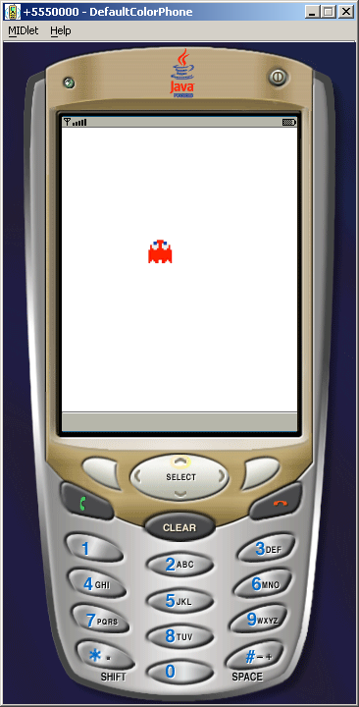

Slide 12
In-Class Exercise
Add audio to this example so that it ‘beeps’ as the character moves left or right.

Slide 13
Defining the Game Playing Field
It is essential to specify a boundary for your game canvas to scale consistently d across different devices.

Slide 14
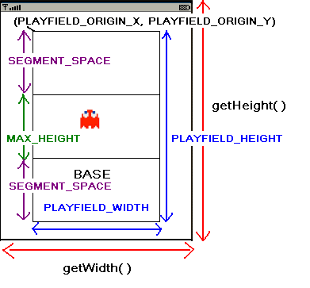

Slide 15
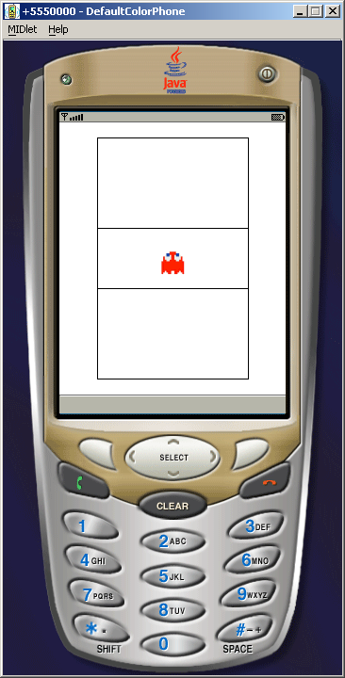

Slide 16
In-Class Exercise
Right now the character moves up and down without key press. Modify the ocde so that pressing up and down keys will only then create such movement.

Slide 17
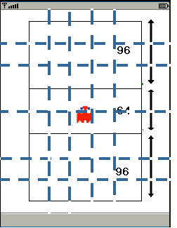
Making the Background More Interesting
Divide your playfield into equal-sized cells. Here, this is a 5 X 8 matrix

Slide 18
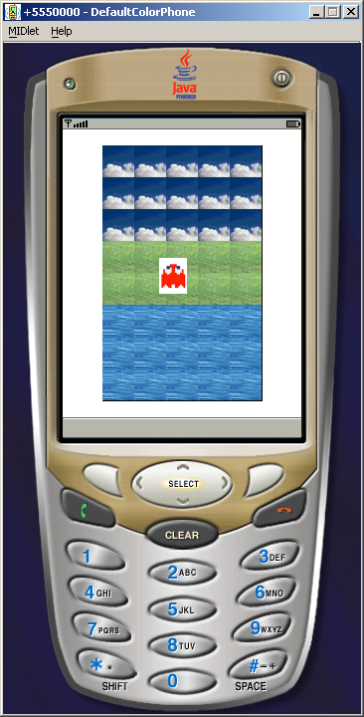

Slide 19
In-Class Exercise
Change the layout from portrait to landscape.

Slide 20
Book References
J2ME Game Programming
http://www.amazon.com/J2ME-Game-Programming-Development/dp/1592001181/ref=pd_bxgy_b_text_b/103-8885581-9975038
J2ME Games with MIDP2
http://www.amazon.com/J2ME-Games-MIDP2-Carol-Hamer/dp/1590593820

Slide 21
Next Class
Will continue discussing Game API and some neat examples.

